Slide 1

Predicting Student
Academic Performance
By: Asma Ali

Slide 2

Motivation

Slide 3
Research
Objective
01
02
03
Providing universities
a framework for using
student data to improve
decision-making
Reduce student failure in universities.
Improve the use of resources in universities

Slide 4

Research
Questions
What are the best used to predict
student performance?
What are the most effective features to
predict students performance?

Slide 5
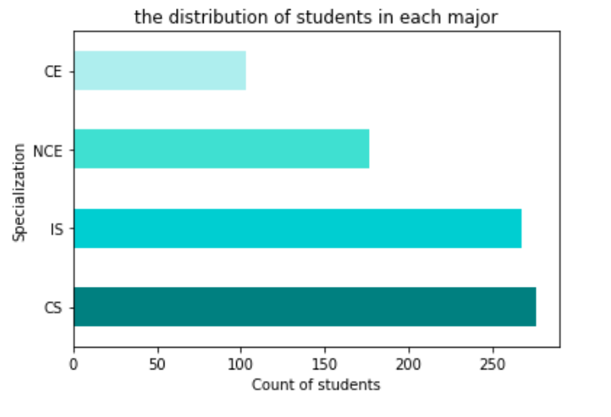
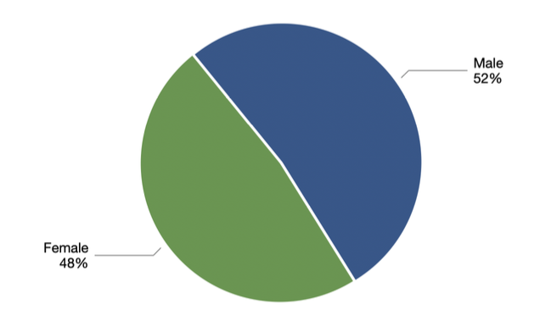
Dataset
1
From King Khalid University
2
824 records

Slide 6


Dataset
1
From King Khalid University
Figure 2: Number of students records for each department
2
824 records
Figure 3:
The ratio of male to female students in the dataset

Slide 7
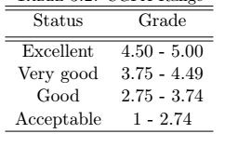
At-risk students
Normal students
Exceeded the regular period of study
Graduated with CGPA less than or equal to 2.75 and exceeded the regular period
Graduated with CGPA is less than 2.7
CGPA is greater than 2.75 and completed their studies in the normal period of the program

Slide 8
At-risk students
Normal students
Exceeded the regular period of study
Graduated with CGPA less than or equal to 2.75 and exceeded the regular period
Graduated with CGPA is less than 2.7
CGPA is greater than 2.75 and completed their studies in the normal period of the program

Slide 9
At-risk students
Normal students
Exceeded the regular period of study
Graduated with CGPA less than or equal to 2.75 and exceeded the regular period
Graduated with CGPA is less than 2.7
CGPA is greater than 2.75 and completed their studies in the normal period of the program

Slide 10
Some features that did not improve the prediction value for
our model were omitted.
Deal with missing data.
Data Pre-processing
Duplicate records and irrelevant features were also removed.
All words were translated into English to facilitate data mining.
Incorrect or in a different format and causing noise in the data
were corrected.

Slide 11
Machine Learning Algorithm
Decision Tree
Random Forest

Slide 12
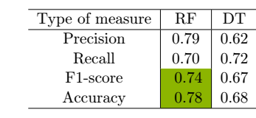
Machine Learning Algorithm
GPA of High school
01
General Aptitude Test(GAT)
Standard Achievement Admission Test (SAAT)
ENG1
ENG2
MATH 1
MATH 2
CSM1
CSM2
Decision Tree
Random Forest
Table2:Comparison of algorithms based on evaluation metrics.

Slide 13
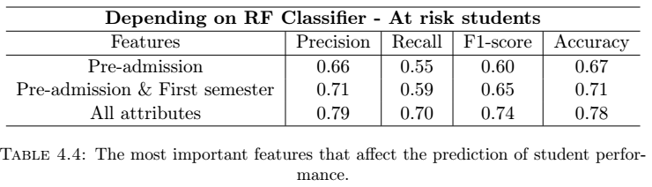
02
What are the main attributes that will influence the prediction of student performance?

Slide 14
Thank you
For your listening

